Slide 1
AI2C Course Intro

Slide 2
Agenda
Scheduling
Introductions

Slide 3
Course Structure
Summer prep (Jul – Aug)
CMU course (Aug – May)
Factory specifics (May – Jun, TBD)

Slide 4
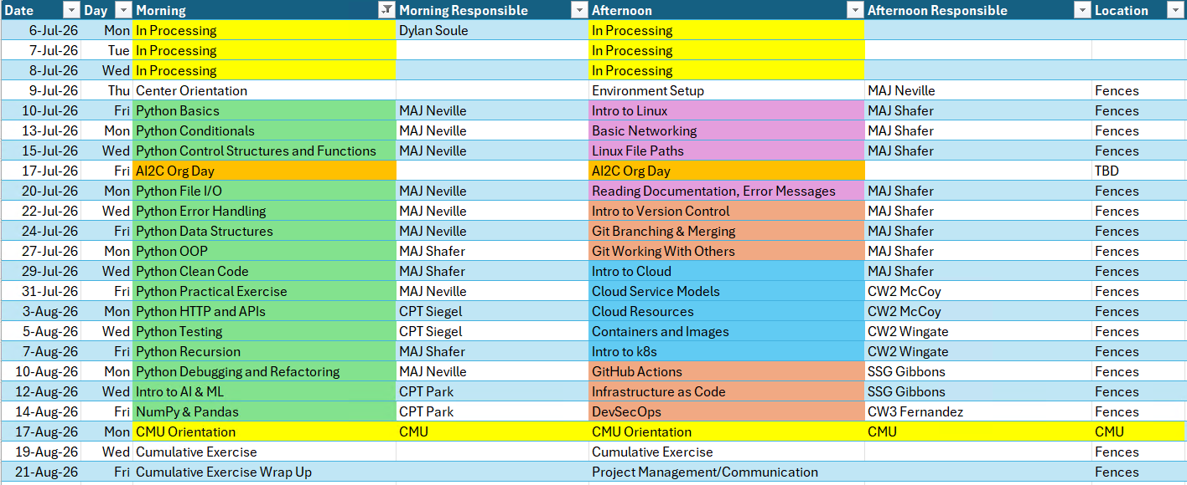
Summer Schedule

Slide 5
CMU Schedule - Fall

Slide 6
CMU Schedule - Spring

Slide 7
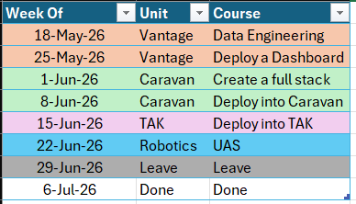
Factory Specifics - TBD

Slide 8
Daily Schedule
0900 – UTC – Morning class
1300 – UTC – Afternoon class

Slide 9
Instructor Intros

Slide 10
Class Intros
Name
Rank
What you do in the Army
Where you're coming from
Your experience level with AI/Tech/Coding

Slide 11
Expectations
College courses
Python experience
DevOps
Cloud
Garbage in, garbage out
Do the material
Optional exercises
Accelerated program, no spoon-feeding
Academic Freedom / Equality
What do you want out of this?

Slide 12
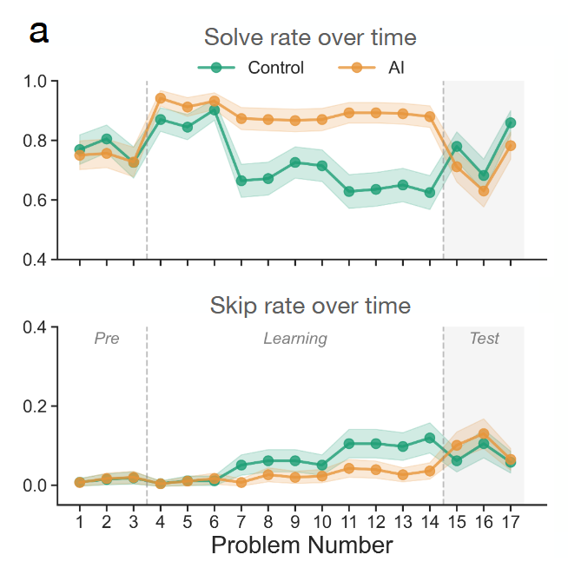
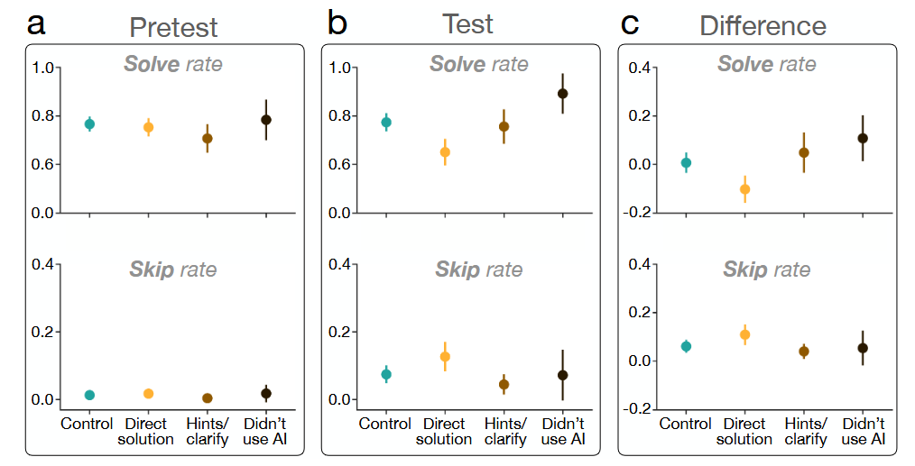
AI Assistance
It’s not “don’t use AI”
It’s “use AI intelligently”
Notes:
Fraction (math) problems
Over 500 participants
Significant differences in groups (ANOVA)
https://arxiv.org/pdf/2604.04721

Slide 13
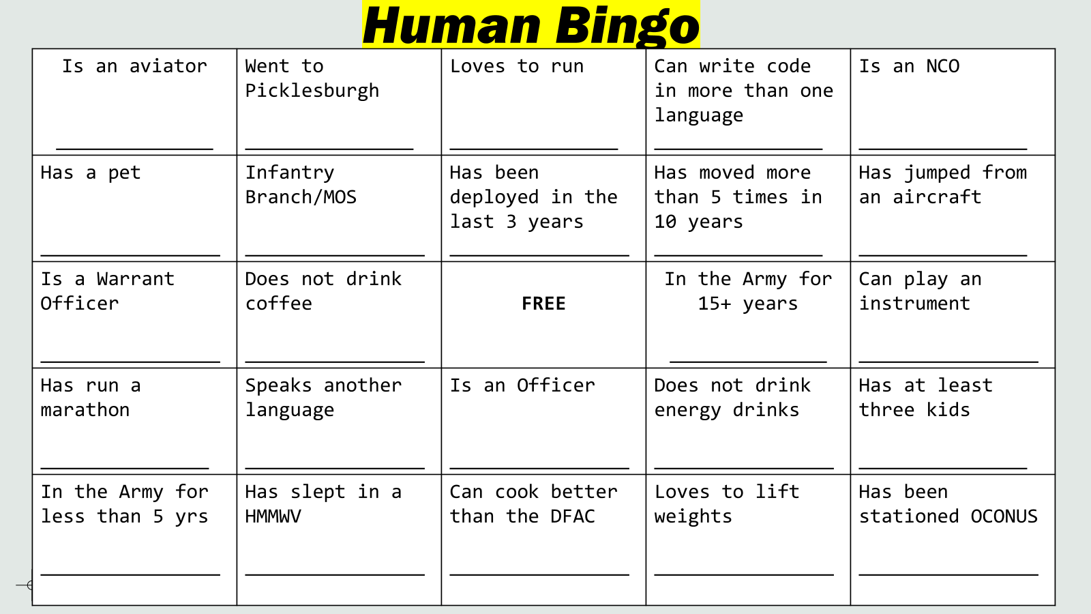
Icebreaker - Human Bingo

Slide 14
Questions

